Slide 1
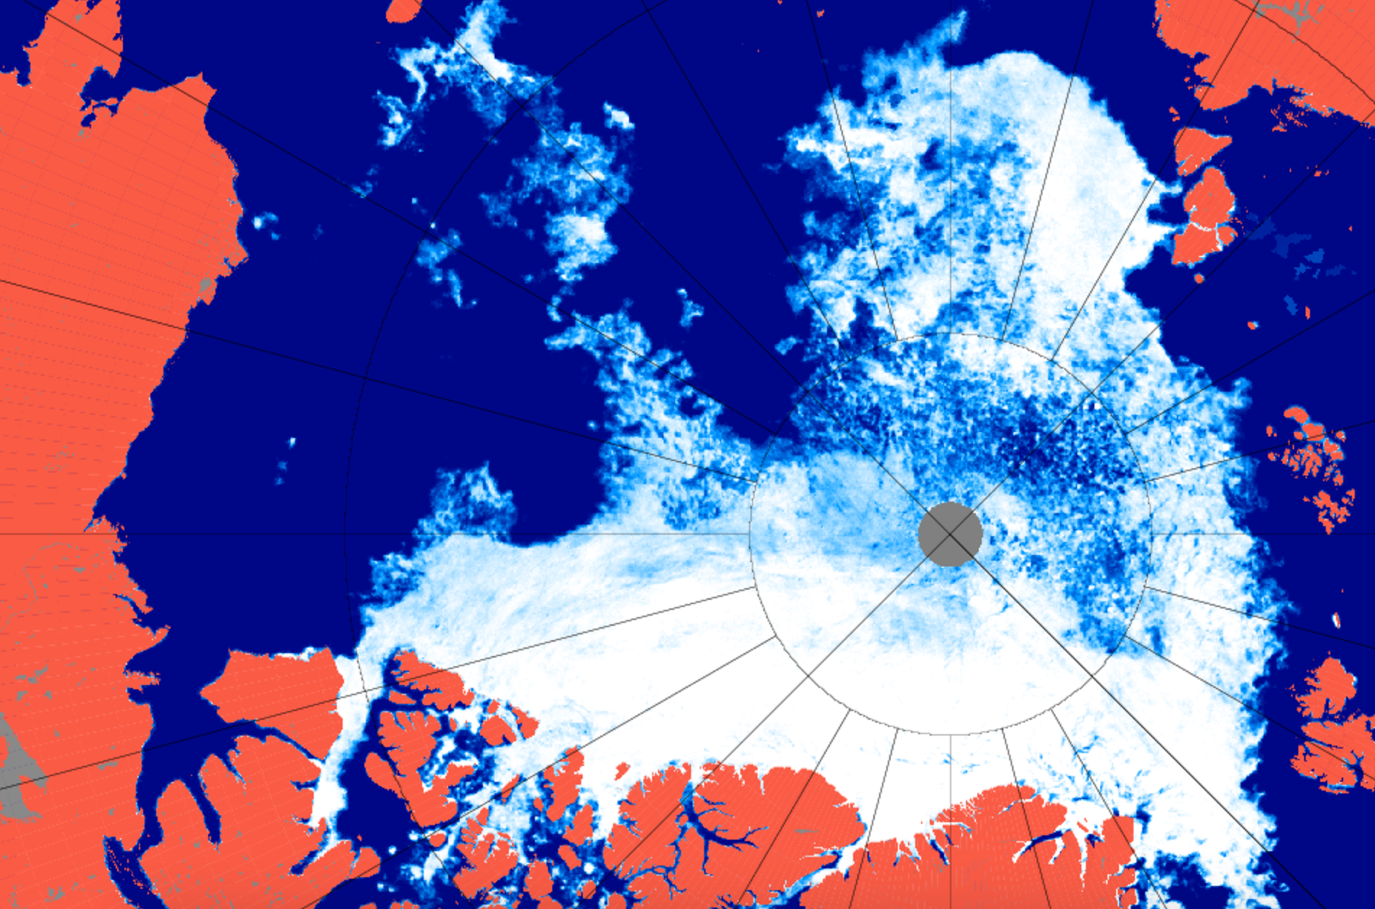
Validation of satellite
sea ice concentration
Zachary Labe
zlabe@uci.edu
@ZLabe
INTPART • Project Proposal • 2017

Slide 2
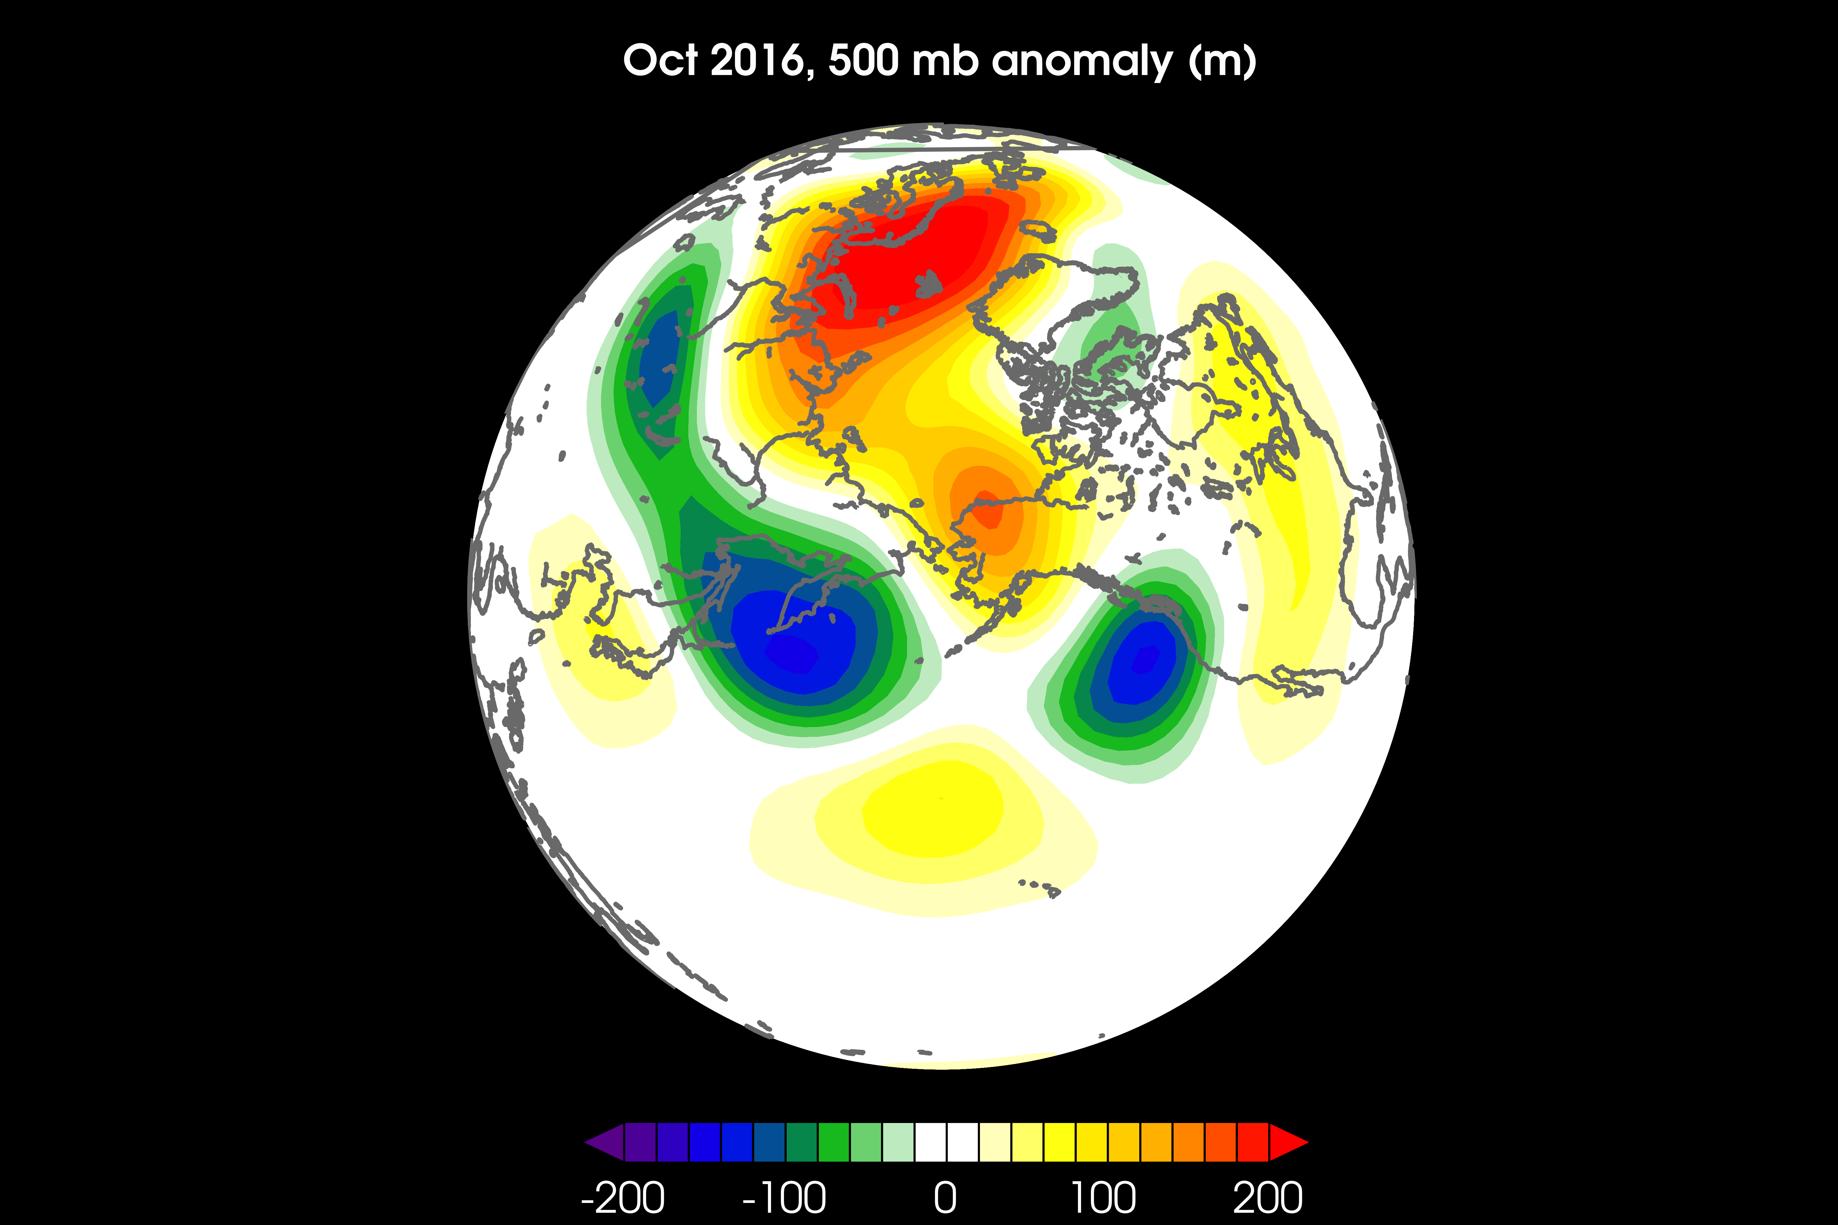
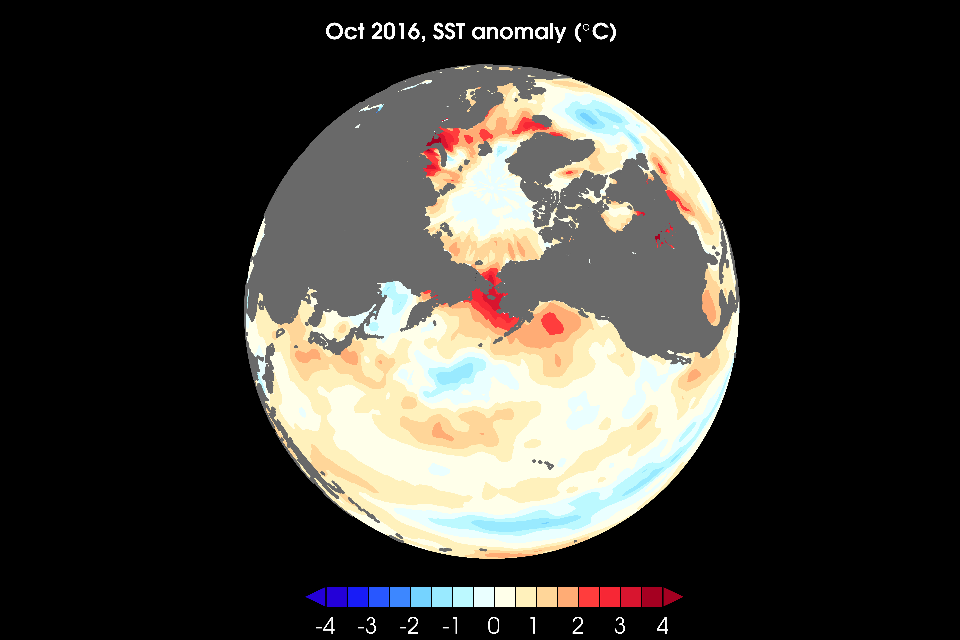
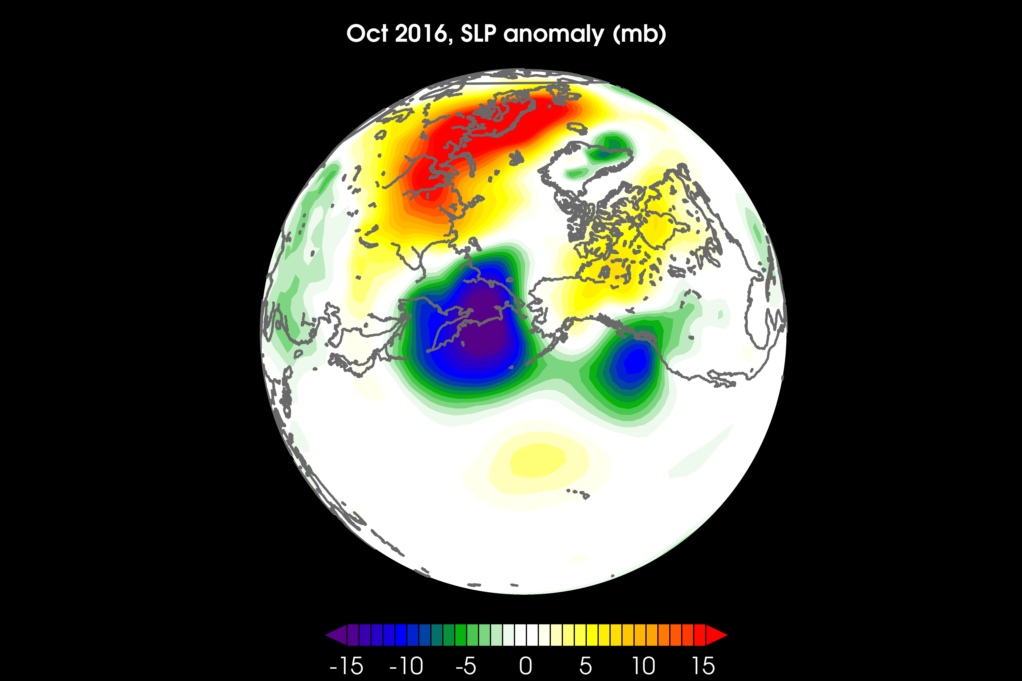
Long-term internal variability of the large-scale atmospheric circulation
Atmospheric forcing and responses to changes in Arctic sea ice cover (and thickness)
Teleconnections between the tropics, midlatitudes, and Arctic
RESEARCH INTERESTS

Slide 3
Long-term internal variability of the large-scale atmospheric circulation
Atmospheric forcing and responses to changes in Arctic sea ice cover (and thickness)
Teleconnections between the tropics, midlatitudes, and Arctic
RESEARCH INTERESTS

Slide 4
Long-term internal variability of the large-scale atmospheric circulation
Atmospheric forcing and responses to changes in Arctic sea ice cover (and thickness)
Teleconnections between the tropics, midlatitudes, and Arctic
RESEARCH INTERESTS

Slide 5
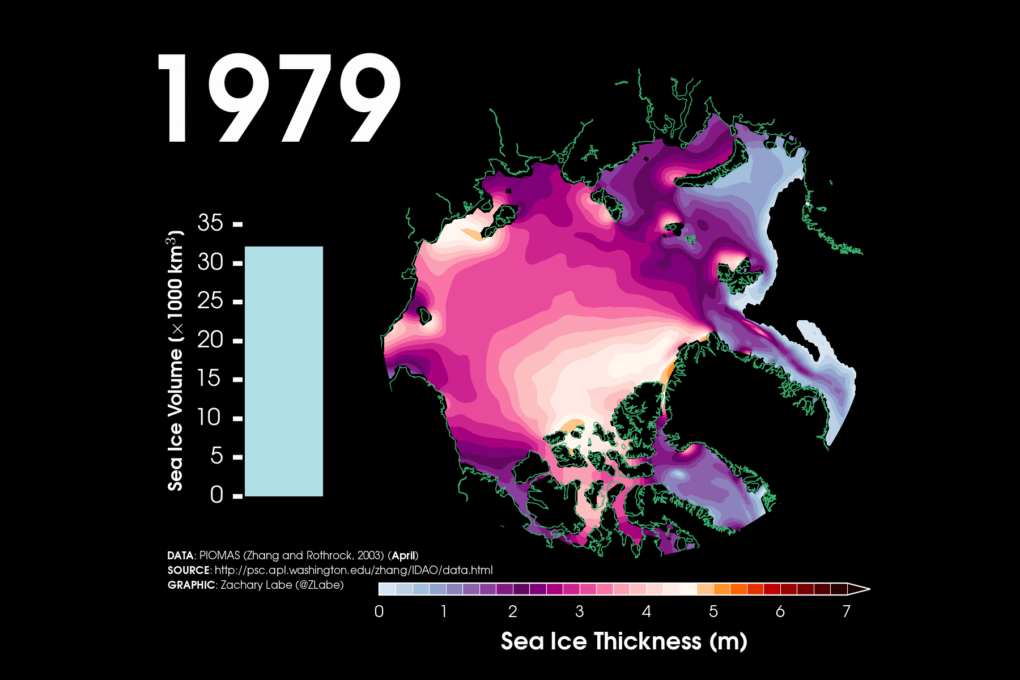
Current Project

Slide 6
Variability of Arctic sea ice thickness

Slide 8
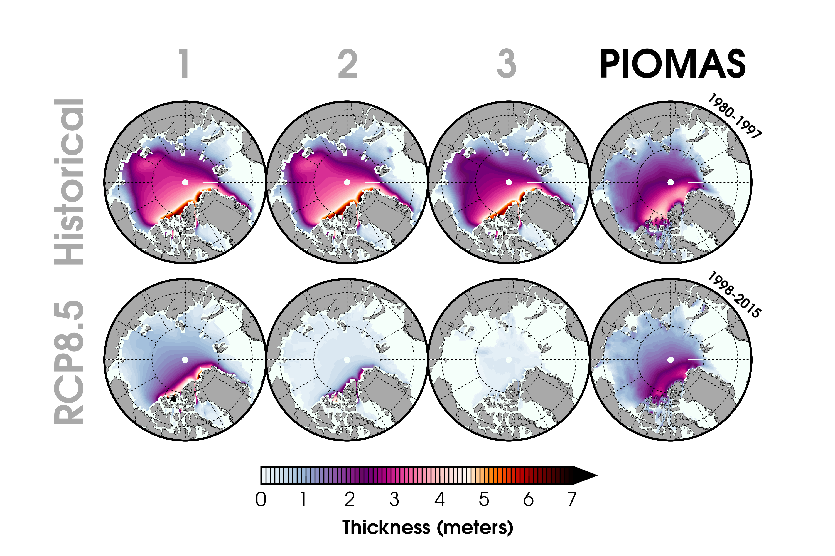
Sea Ice Thickness

Slide 9
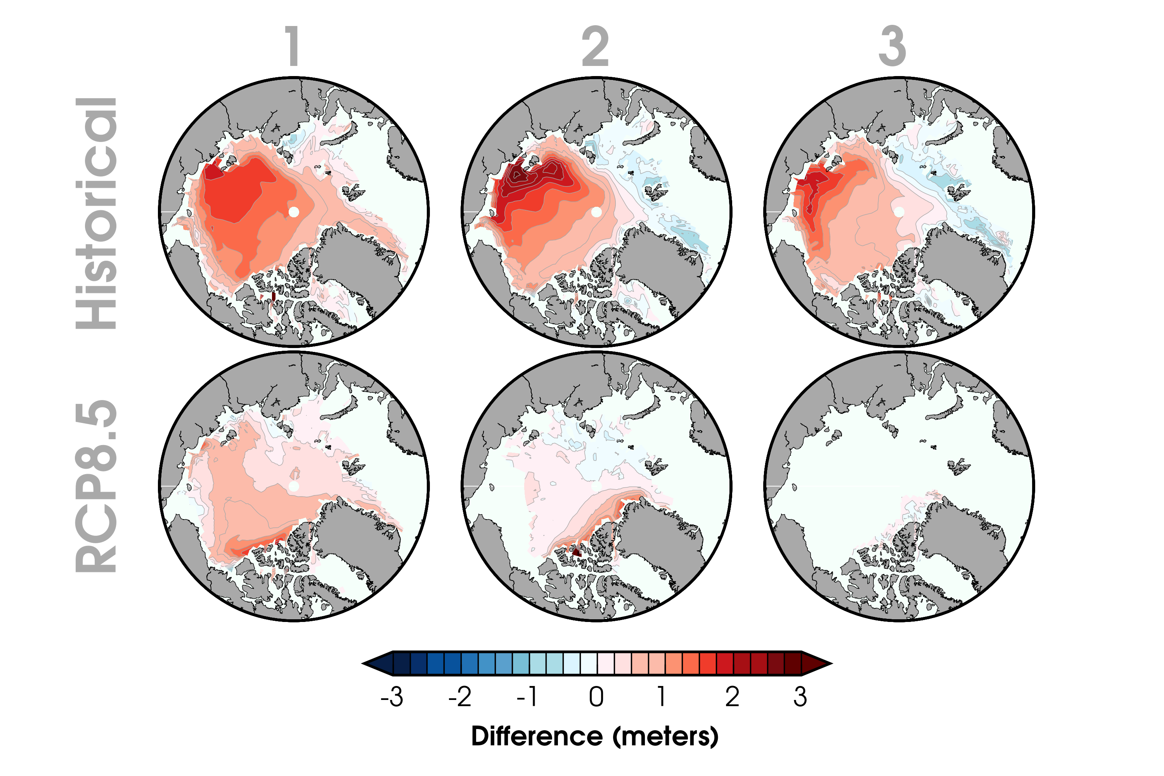
Sea Ice Thickness

Slide 10
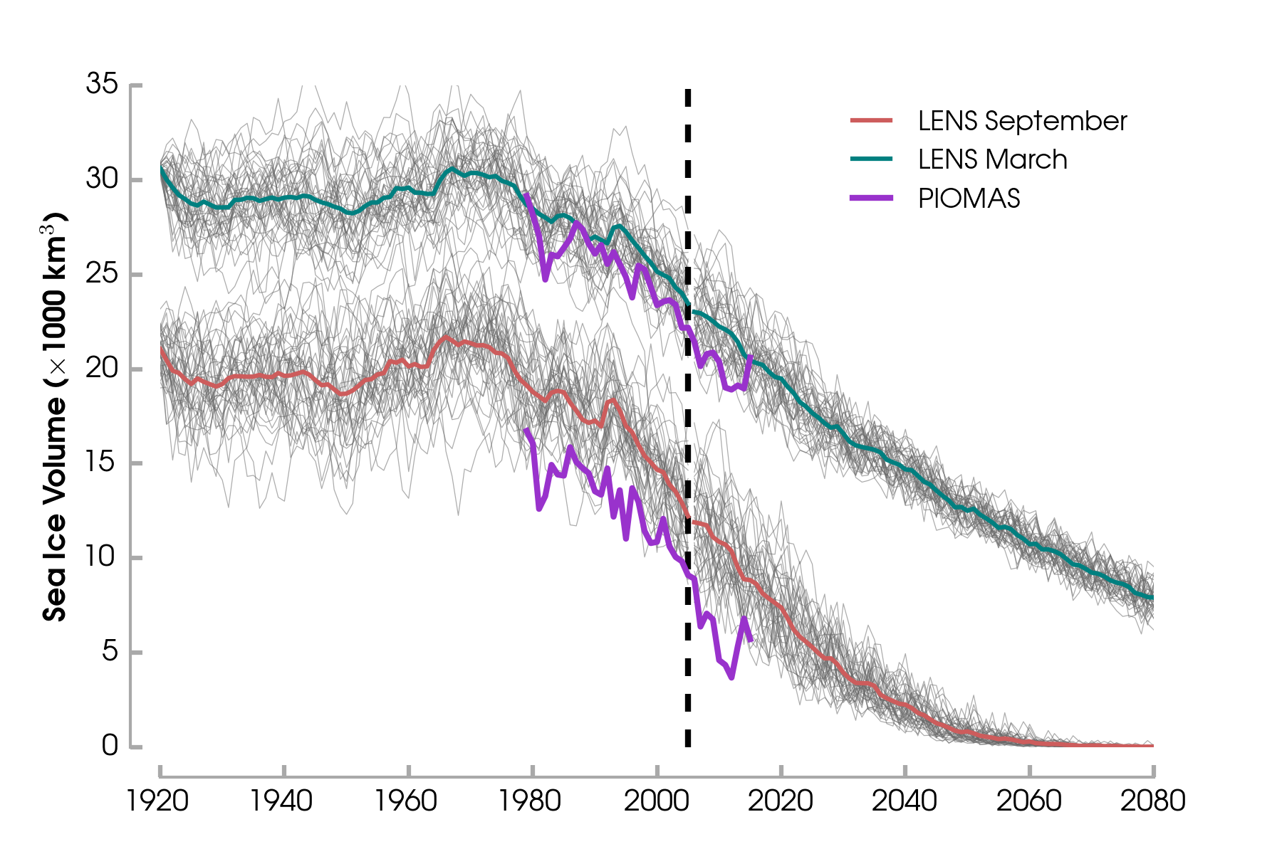
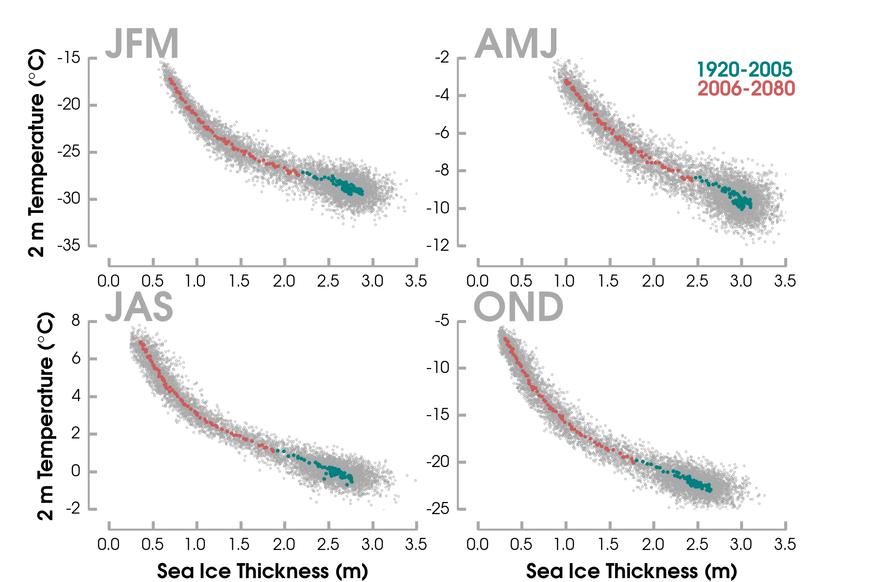
Sea Ice Thickness

Slide 11
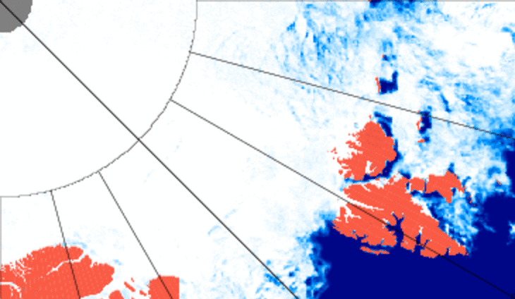
R/V Lance – 18 May : 24 May
INTPART Project

Slide 12
R/V Lance – 18 May : 24 May

Slide 13
AMSR2 - ASI 3.125 km - Sea Ice Conc.

Slide 14
Compare sea ice observations (SIC(8))

Slide 15
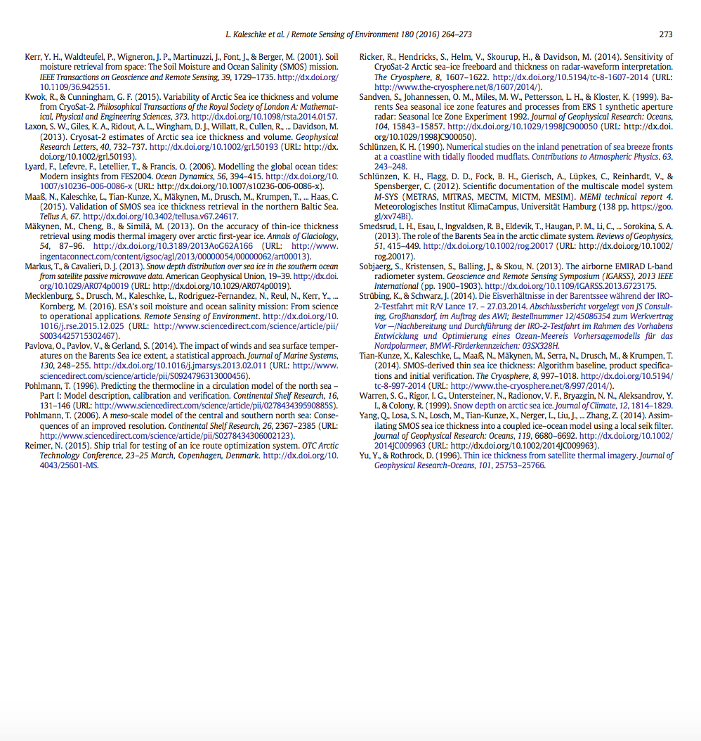
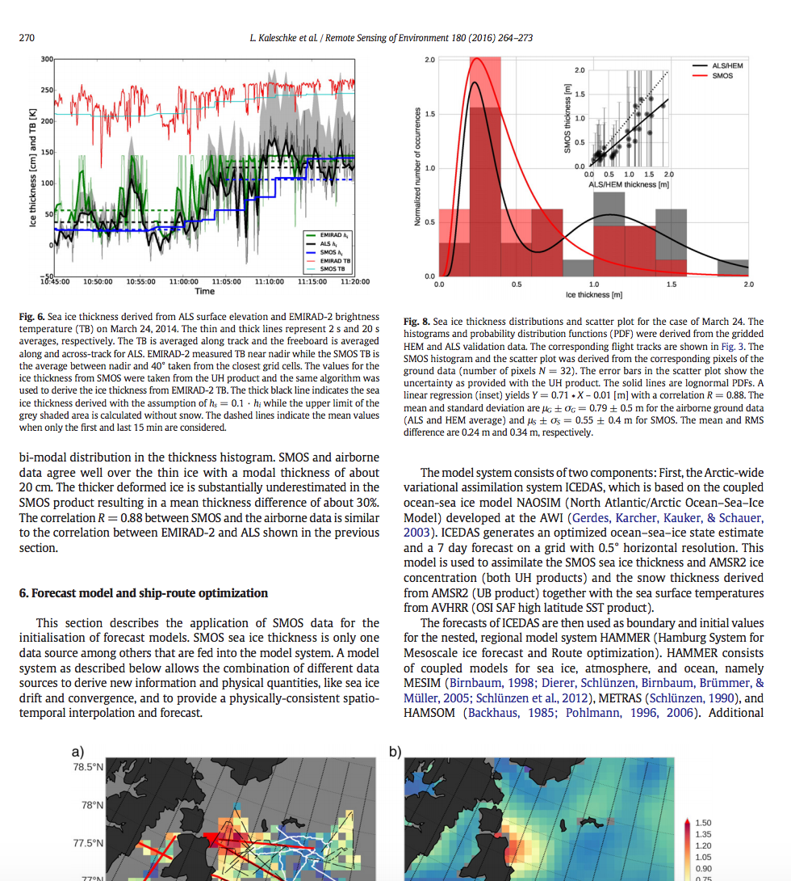
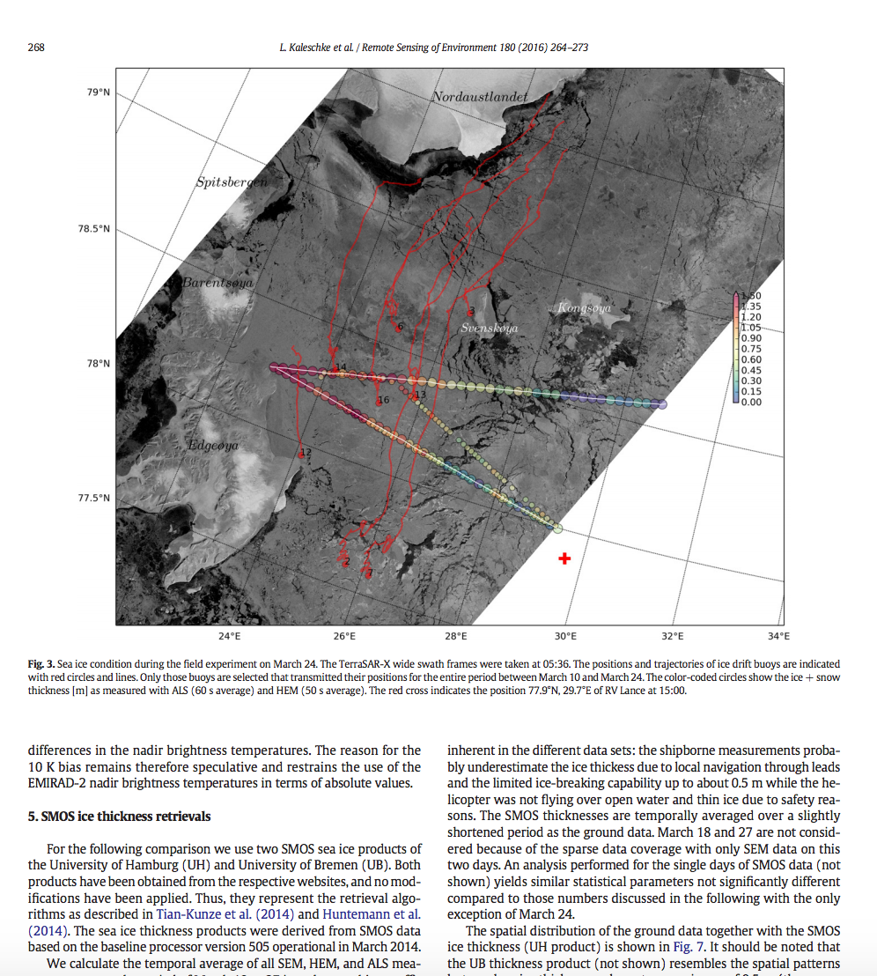
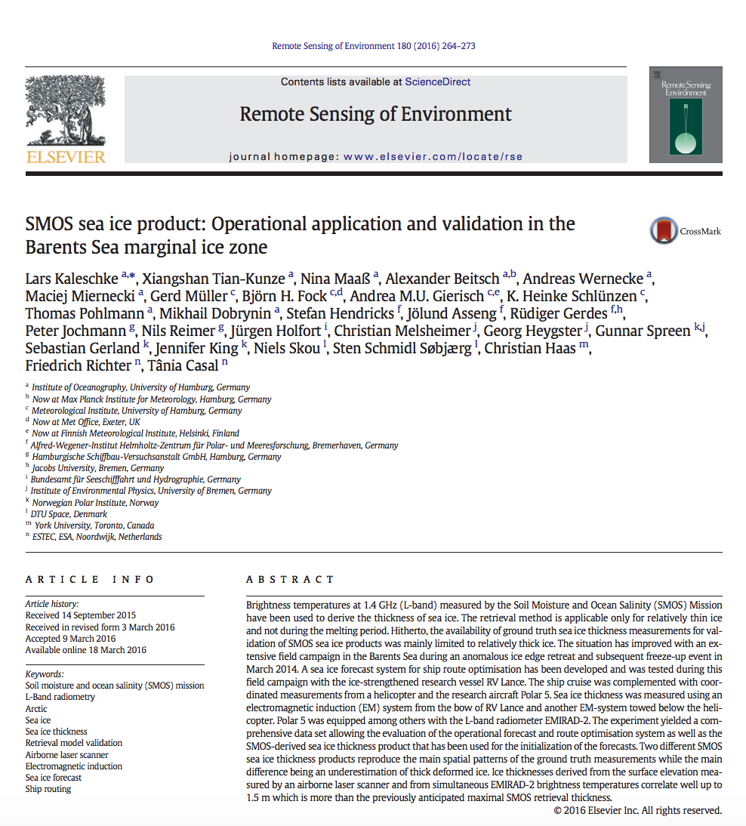
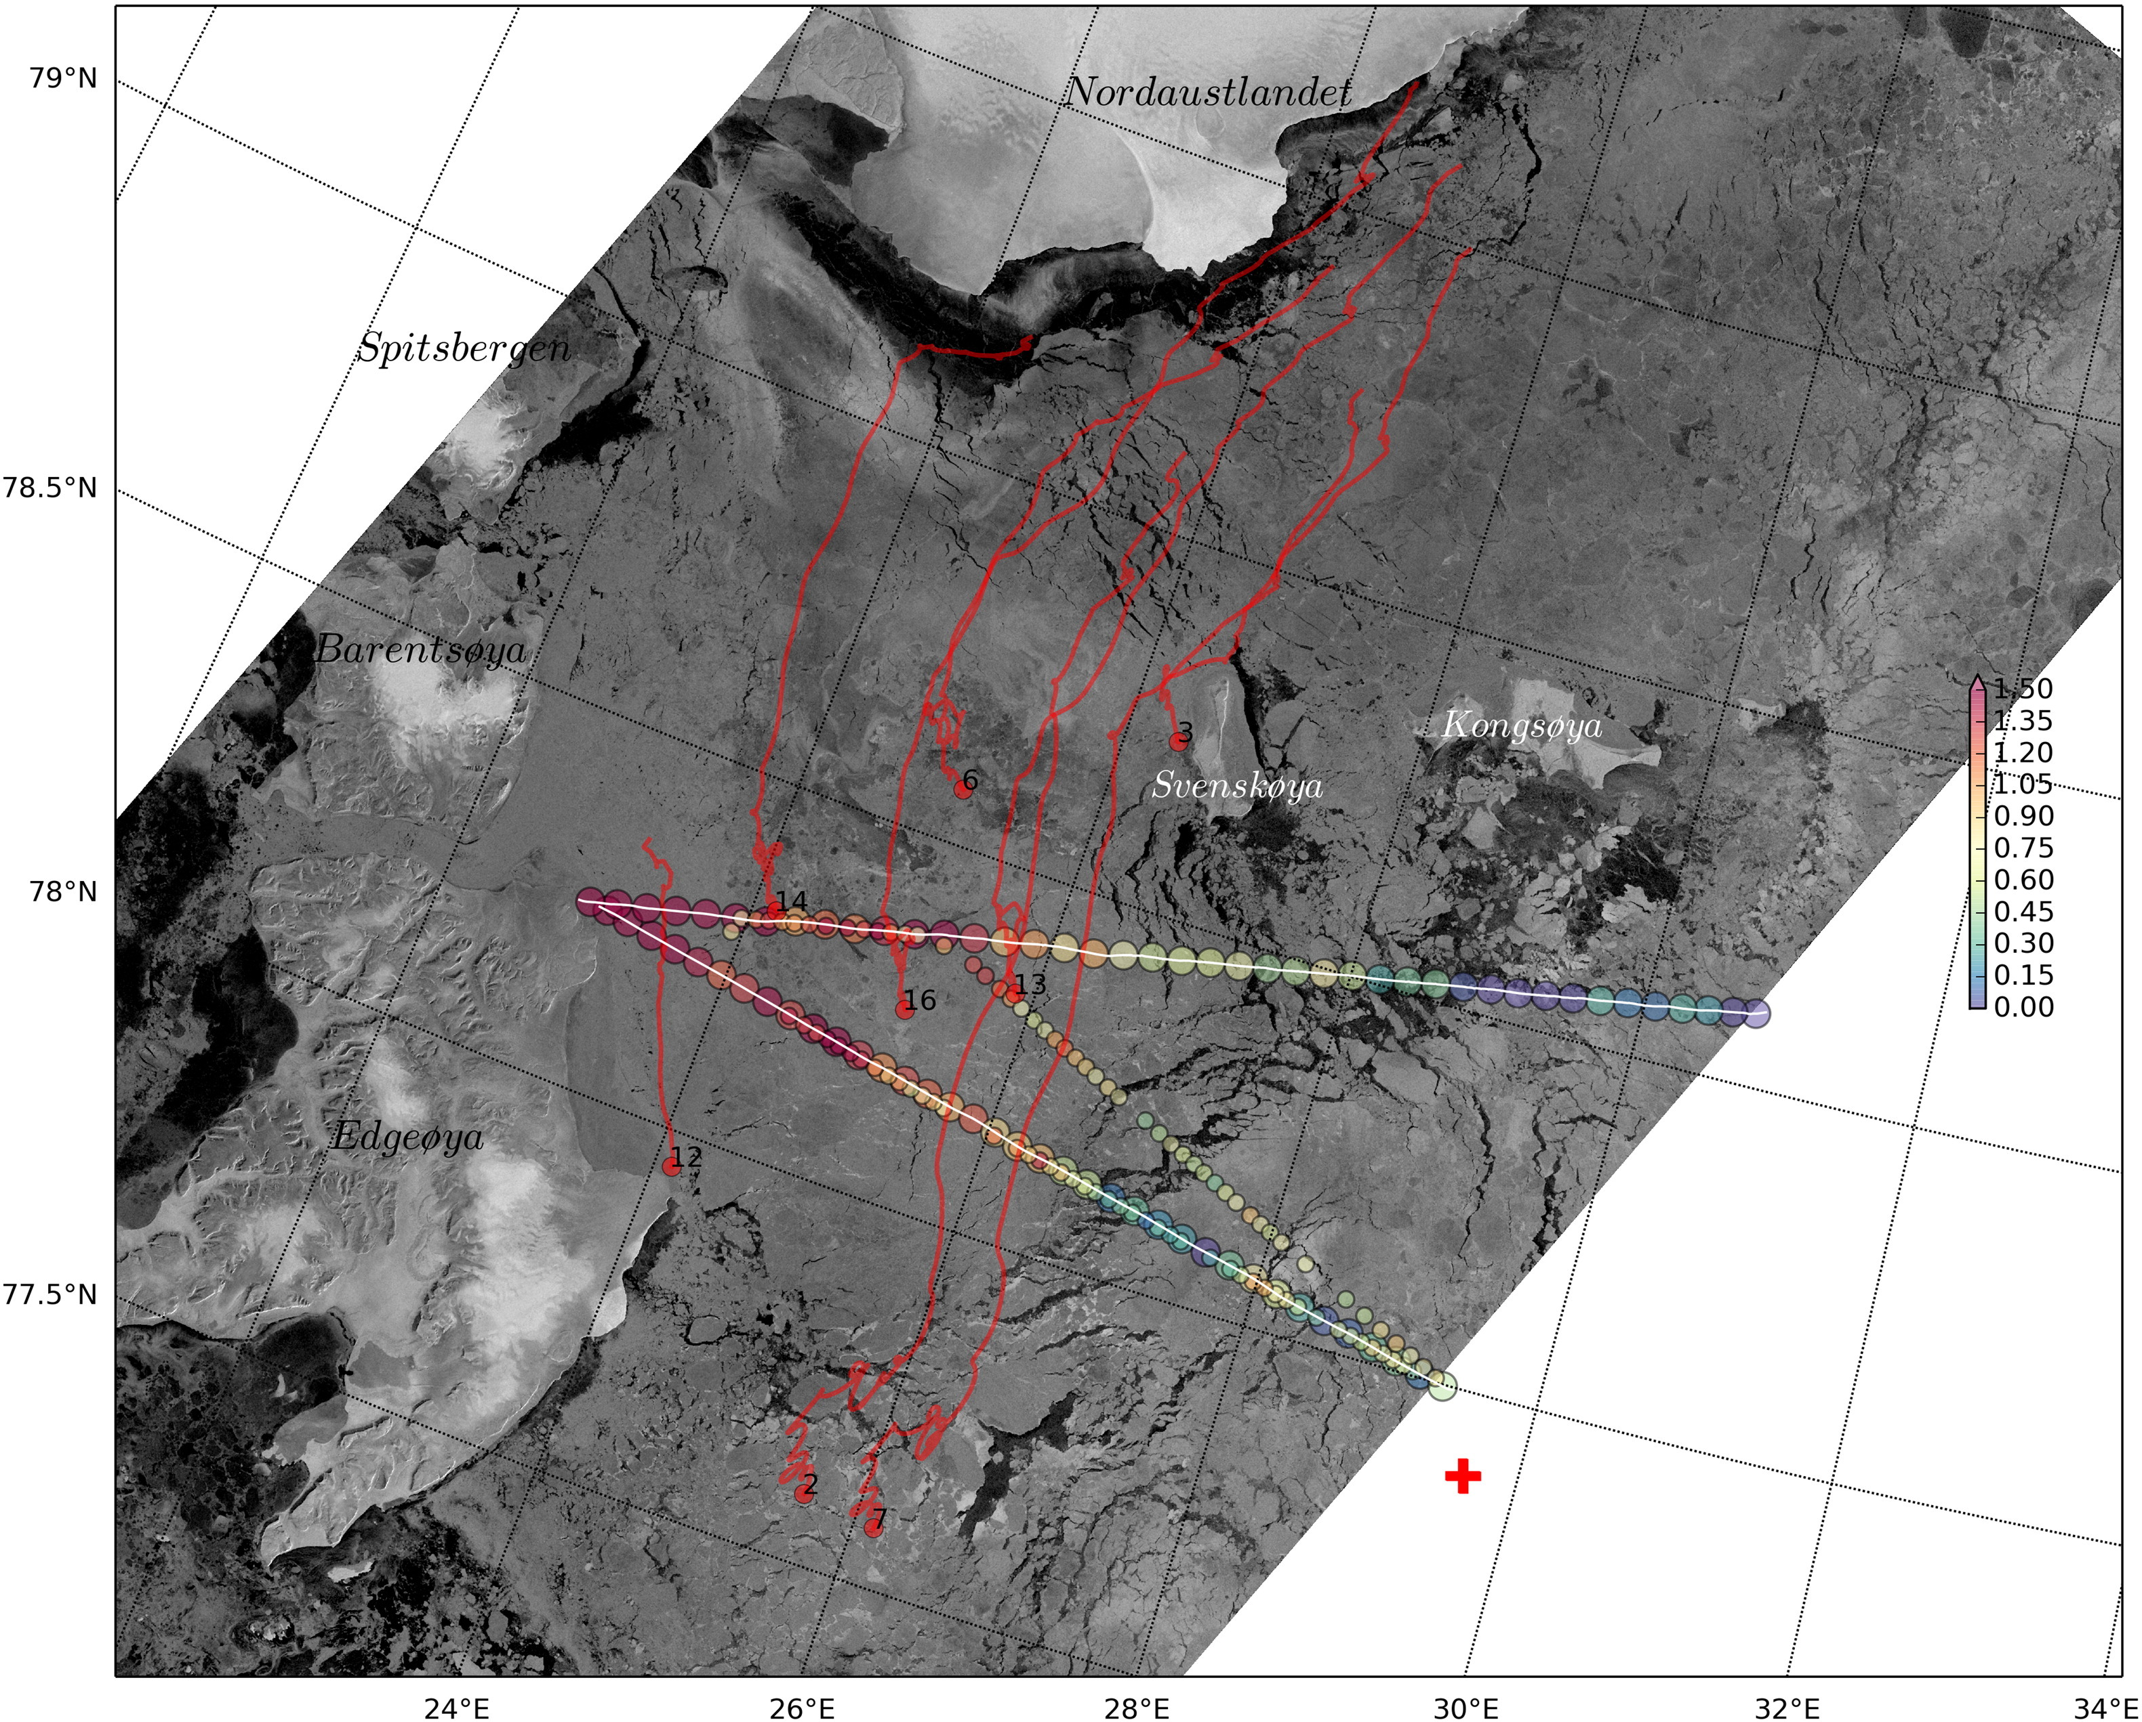
Prior sea ice thickness (SMOS) validation with the R/V Lance
• SMOS reproduces the spatial patterns of sea ice thickness in the Barents Sea
Kaleschke et al. [2015]

Slide 16
What are the advantages and concerns in the passive microwave satellite record of (pan-Arctic) sea ice?
Importance of using ground observations as validation/uncertainty for remote sensing and climate models
Opportunities in pan-Arctic remote sensing
KEY POINTS

